Slide 1


Unit Testing

Slide 2


Agenda
Introduction to testing
Testing types
Testing levels
Unit tests
Nunit
Examples
Notes:
Agenda Slide (version B)
This slide should provide the audience with the “chapters” of the “story.”
Change the header and footer in the master slides to reflect the client name and presentation name.
These chapter titles should match the Chapter Intro Slides throughout the deck (see slide 4).
There are two versions of this slide: black and white (see previous slide).

Slide 3

1
Introduction to testing
Notes:
Chapter Intro Slide (version J)
This slide should be used at the beginning of each “chapter” of your presentation (as introduced in the Agenda slide) to keep the audience aware of their place in the story and to help break things up. Change the text and chapter number accordingly. If you do not need a sub-head (the smaller text), delete it. Use different backgrounds for different chapter titles, try not to repeat a background.
Very short presentations (< ~10 slides) may not need Chapter Intro Slides.
There are multiple versions of this template with various white and black background images starting on slide 10.

Slide 4

NUnit - 1. Introduction to testing
What is testing?
Any deviation from the product requirements is a defect.
If they are met, that doesn’t mean the product has no issues.
Golden question: „What happenes if...”.

Slide 5

NUnit - 1. Introduction to testing
When does testing stop?

Slide 6

NUnit - 1. Introduction to testing
Answer: NEVER
Why?
All code is guilty until proven innocent.
No matter how many tests you write, you can’t prove a software is right, yet a single test can prove a software wrong.

Slide 7
2
Testing types
Notes:
Chapter Intro Slide (version J)
This slide should be used at the beginning of each “chapter” of your presentation (as introduced in the Agenda slide) to keep the audience aware of their place in the story and to help break things up. Change the text and chapter number accordingly. If you do not need a sub-head (the smaller text), delete it. Use different backgrounds for different chapter titles, try not to repeat a background.
Very short presentations (< ~10 slides) may not need Chapter Intro Slides.
There are multiple versions of this template with various white and black background images starting on slide 10.

Slide 8
NUnit - 2. Testing types
1. White Box testing
Also known as Glass Box, Clear Box Testing.
Usually the internal aspects of the system are well known when writing test cases.
Done at the unit level.

Slide 9
NUnit - 2. Testing types
2. Black Box testing
Also known as Input-Output testing.
Internal aspects of the system are not known.

Slide 10
NUnit - 2. Testing types
3. Grey Box testing
A combination of the other two.
The tester needs to know internal aspects to write better test cases.

Slide 11
3
Testing Levels
Notes:
Chapter Intro Slide (version J)
This slide should be used at the beginning of each “chapter” of your presentation (as introduced in the Agenda slide) to keep the audience aware of their place in the story and to help break things up. Change the text and chapter number accordingly. If you do not need a sub-head (the smaller text), delete it. Use different backgrounds for different chapter titles, try not to repeat a background.
Very short presentations (< ~10 slides) may not need Chapter Intro Slides.
There are multiple versions of this template with various white and black background images starting on slide 10.

Slide 12
NUnit - 3. Testing levels
Manual tests
System tests
Integration tests
Component tests
Unit tests

Slide 13

NUnit - 3. Testing levels
Manual tests
The process of manually testing software for finding software flaws.
Tester must play the role of the end user to check if the application works as expected.

Slide 14

NUnit - 3. Testing levels
System tests
The process of testing a complete integrated system to evaluate the system’s compliance with its specified components.
Takes as input all the integrated components that passed the integration testing.

Slide 15

NUnit - 3. Testing levels
Integration tests
The process of testing individual software modules as a group.
Takes as input modules that have been unit tested.

Slide 16

NUnit - 3. Testing levels
Component-based testing
The process of testing the usability and behaviour of an interraction component.
Takes as input a component in an independent and controllable state (i.e. a radio button).

Slide 17
4
Unit tests
Notes:
Chapter Intro Slide (version J)
This slide should be used at the beginning of each “chapter” of your presentation (as introduced in the Agenda slide) to keep the audience aware of their place in the story and to help break things up. Change the text and chapter number accordingly. If you do not need a sub-head (the smaller text), delete it. Use different backgrounds for different chapter titles, try not to repeat a background.
Very short presentations (< ~10 slides) may not need Chapter Intro Slides.
There are multiple versions of this template with various white and black background images starting on slide 10.

Slide 18
NUnit - 4. Unit tests
Unit tests
A unit test is code written by a developer to test a single pice of functionality.
The pice of functionality must be as small as possible.
One unit may have multiple test units according to its input, usage and output.

Slide 19
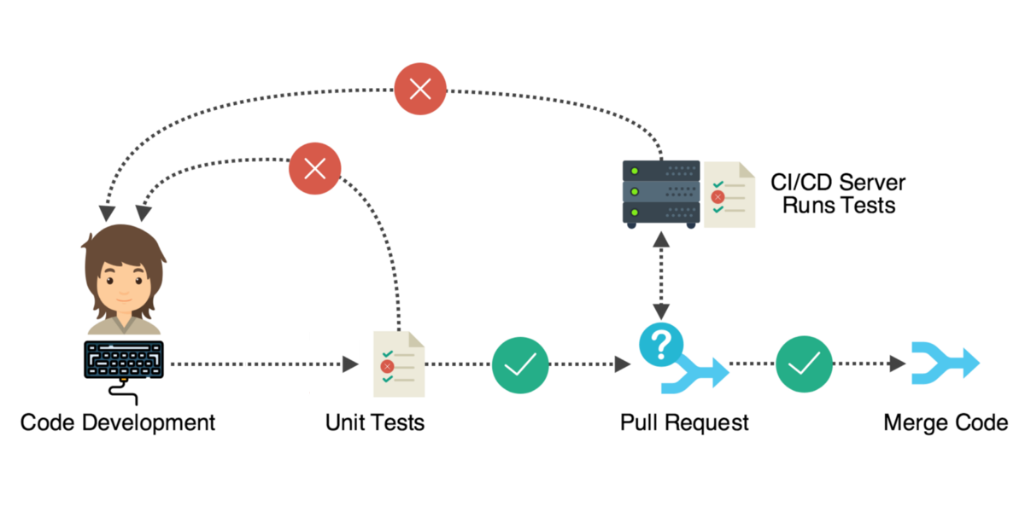
NUnit - 4. Unit tests
How should unit testing be done?
Notes:
Standard text slide (version 3)
Use standard text slides as little as possible. They can be used for an introduction to a presentation, summary of work, detailed legal information.
All presentations should be a mix of text-heavy pages and visual pages.
In a presentation, choose between 1, 2, or 3 column text pages to be consistent within the document.

Slide 20
NUnit - 4. Unit tests
How unit tests must be
Automated and repetable.
Easy to implement.
Relevant tomorrow.
Able to run for every team member at the push of a button.
Run quickly.
Consistent in the returned results.
In full control of the unit under test.
Fully isolated.
Like a map to the dev in case of failure to help pinpoint the problem.

Slide 21


NUnit - 4. Unit tests
General approach towards doing unit testing

Slide 22
5
NUnit
Notes:
Chapter Intro Slide (version J)
This slide should be used at the beginning of each “chapter” of your presentation (as introduced in the Agenda slide) to keep the audience aware of their place in the story and to help break things up. Change the text and chapter number accordingly. If you do not need a sub-head (the smaller text), delete it. Use different backgrounds for different chapter titles, try not to repeat a background.
Very short presentations (< ~10 slides) may not need Chapter Intro Slides.
There are multiple versions of this template with various white and black background images starting on slide 10.

Slide 23

NUnit - 5. NUnit
NUnit
Unit-testing framework for .NET applications.

Slide 24
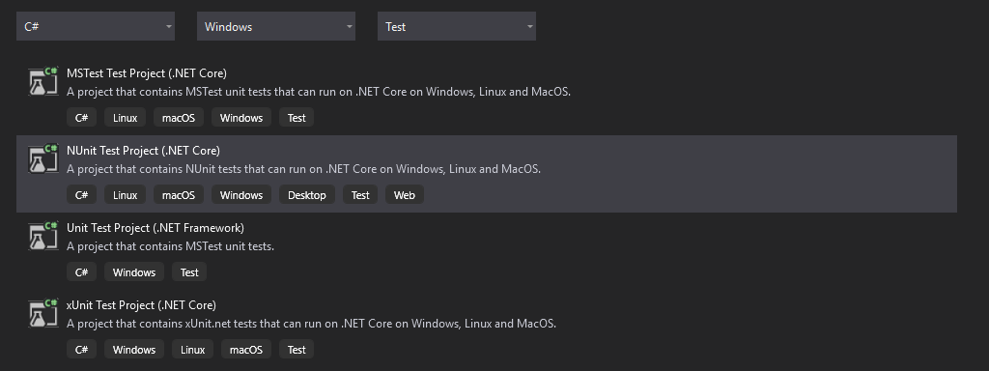
NUnit - 5. NUnit
Initial setup

Slide 25
NUnit - 5. NUnit
My first test class
[TestFixture]
public class Tests
{
[Setup]
public void Setup()
{
}
[TearDown]
public void TearDown()
{
}
[Test]
public void Test()
{
Assert.Pass();
}
}

Slide 26
NUnit - 5. NUnit
Attributes: [TestFixture]
[TestFixture]
public class Tests
{
[Setup]
public void Setup()
{
}
[TearDown]
public void TearDown()
{
}
[Test]
public void Test()
{
Assert.Pass();
}
}
Marks a class that contains tests and, optionally, setup or teardown methods.

Slide 27
NUnit - 5. NUnit
Attributes: [Setup]
[TestFixture]
public class Tests
{
[Setup]
public void Setup()
{
}
[TearDown]
public void TearDown()
{
}
[Test]
public void Test()
{
Assert.Pass();
}
}
Provides a common set of functions that are performed just before each test method is called.
A TestFixture can have only one SetUp method.

Slide 28
Client Name Presentation Title - 1. Chapter Name
Attributes: [TearDown]
[TestFixture]
public class Tests
{
[Setup]
public void Setup()
{
}
[TearDown]
public void TearDown()
{
}
[Test]
public void Test()
{
Assert.Pass();
}
}
The TearDown attribute is used inside a TestFixture to provide a common set of functions that are performed after each test method is run.
A TestFixture can have only one TearDown method.

Slide 29
NUnit - 5. NUnit
Attributes: [Test]
[TestFixture]
public class Tests
{
[Setup]
public void Setup()
{
}
[TearDown]
public void TearDown()
{
}
[Test]
public void Test()
{
Assert.Pass();
}
}
The Test attribute marks a specific method inside a class that has already been marked as a TestFixture, as a test method.

Slide 30
NUnit - 5. NUnit
Other frequently used attributes
[TestFixture]
public class Tests
{ [Test, Timeout(100)]
public void Test_1()
{
Thread.Sleep(101);
Assert.Pass();
}
[Test]
[Ignore("Not used")]
public void Test_2()
{
Assert.Fail("Used");
}
[Test]
public void Test_4([Values(2, 4)] int x)
{
Assert.Positive(x);
}
}
[Timeout]
[Ignore]
[Values]

Slide 31
NUnit - 5. NUnit
Assertions
Central to unit testing.
Static methods of the Assert class.
There is a rich set of assertions.
In NUnit3 assertions are written primarily using the Assert.That method (Constraint Model).
In earlier versions a separate method of the Assert class was used (Calssic Model).
Assert.That(2+2, Is.EqualTo(4)); //constraint model
Assert.AreEqual(4, 2+2); //classic model

Slide 32
NUnit - 5. Examples
Examples
int number = 5;
Assert.That(number, Is.GreaterThan(4).And.LessThan(10));
Assert.That(number, Is.Not.EqualTo(7));
Assert.That(number, Is.GreaterThanOrEqualTo(5));
int[] array = new int[] { 1, 2, 3, 4, 5 };
Assert.That(array, Is.All.Not.Null);
Assert.That(array, Is.All.GreaterThan(0));
Assert.That(array, Is.All.LessThan(10));
Assert.That(array, Is.All.InstanceOf<int32>());
Assert.That(array, Is.Not.Empty);
Assert.That(array, Has.Exactly(5).Items);
Assert.That(array, Is.Unique);
Assert.That(array, Contains.Item(4));
Assert.That(array, Is.Ordered.Ascending);

Slide 33
NUnit - 5. Examples
More examples
string word = "abcdefg";
Assert.That(word, Is.EqualTo("abcdefg"));
Assert.That(word, Is.Not.EqualTo("mnop"));
Assert.That(word, Is.EqualTo("abcdefg").IgnoreCase);
Assert.That(word, Does.Contain("def").IgnoreCase);
Assert.That(word, Is.Empty);
Assert.That(word, Does.StartWith("abc"));
Assert.That(word, Does.Match("a*g"));
IEmployee emp = new Employee();
emp.Age = 0;
Assert.That(emp, Is.InstanceOf<IEmployee>());
Assert.That(emp, Is.Not.InstanceOf<string>());
Assert.That(emp, Is.TypeOf<Employee>());
Assert.That(emp, Is.AssignableTo<Employee>());
Assert.That(emp.IsSeniorCitizen(), Throws.Exception);
Exception ex = Assert.Throws<ArgumentException>(() => emp.IsSeniorCitizen());
Assert.That(ex.Message, is.EqualTo("Age can not 0."));

Slide 34
Client Name Presentation Title - 1. Chapter Name
References
https://docs.nunit.org/articles/nunit/intro.html
http://dotnetpattern.com/nunit-assert-examples
https://www.toptal.com/qa/how-to-write-testable-code-and-why-it-matters

